Slide 1
Unix Shell/Command Line
Welcome!

Slide 2

The Command Line is like the woods

Slide 3
Agenda for the day!
Introductions
What is a shell?
What is a hierarchy?
What is a command?
Where can I go for help?
Learning outcome: Build confidence in how to interact with the command line.

Slide 4
Code of Conduct
Let’s keep this a constructive and supportive environment
We’re all learning
I very much appreciate feedback

Slide 5
Introductions!
My name is Gregory Porter. I am a software engineer for the Transdisciplinary Institute in Applied Data Sciences.
Let’s go around the room:
Name and Department

Slide 6

Part 1 - What is a shell?

Slide 7
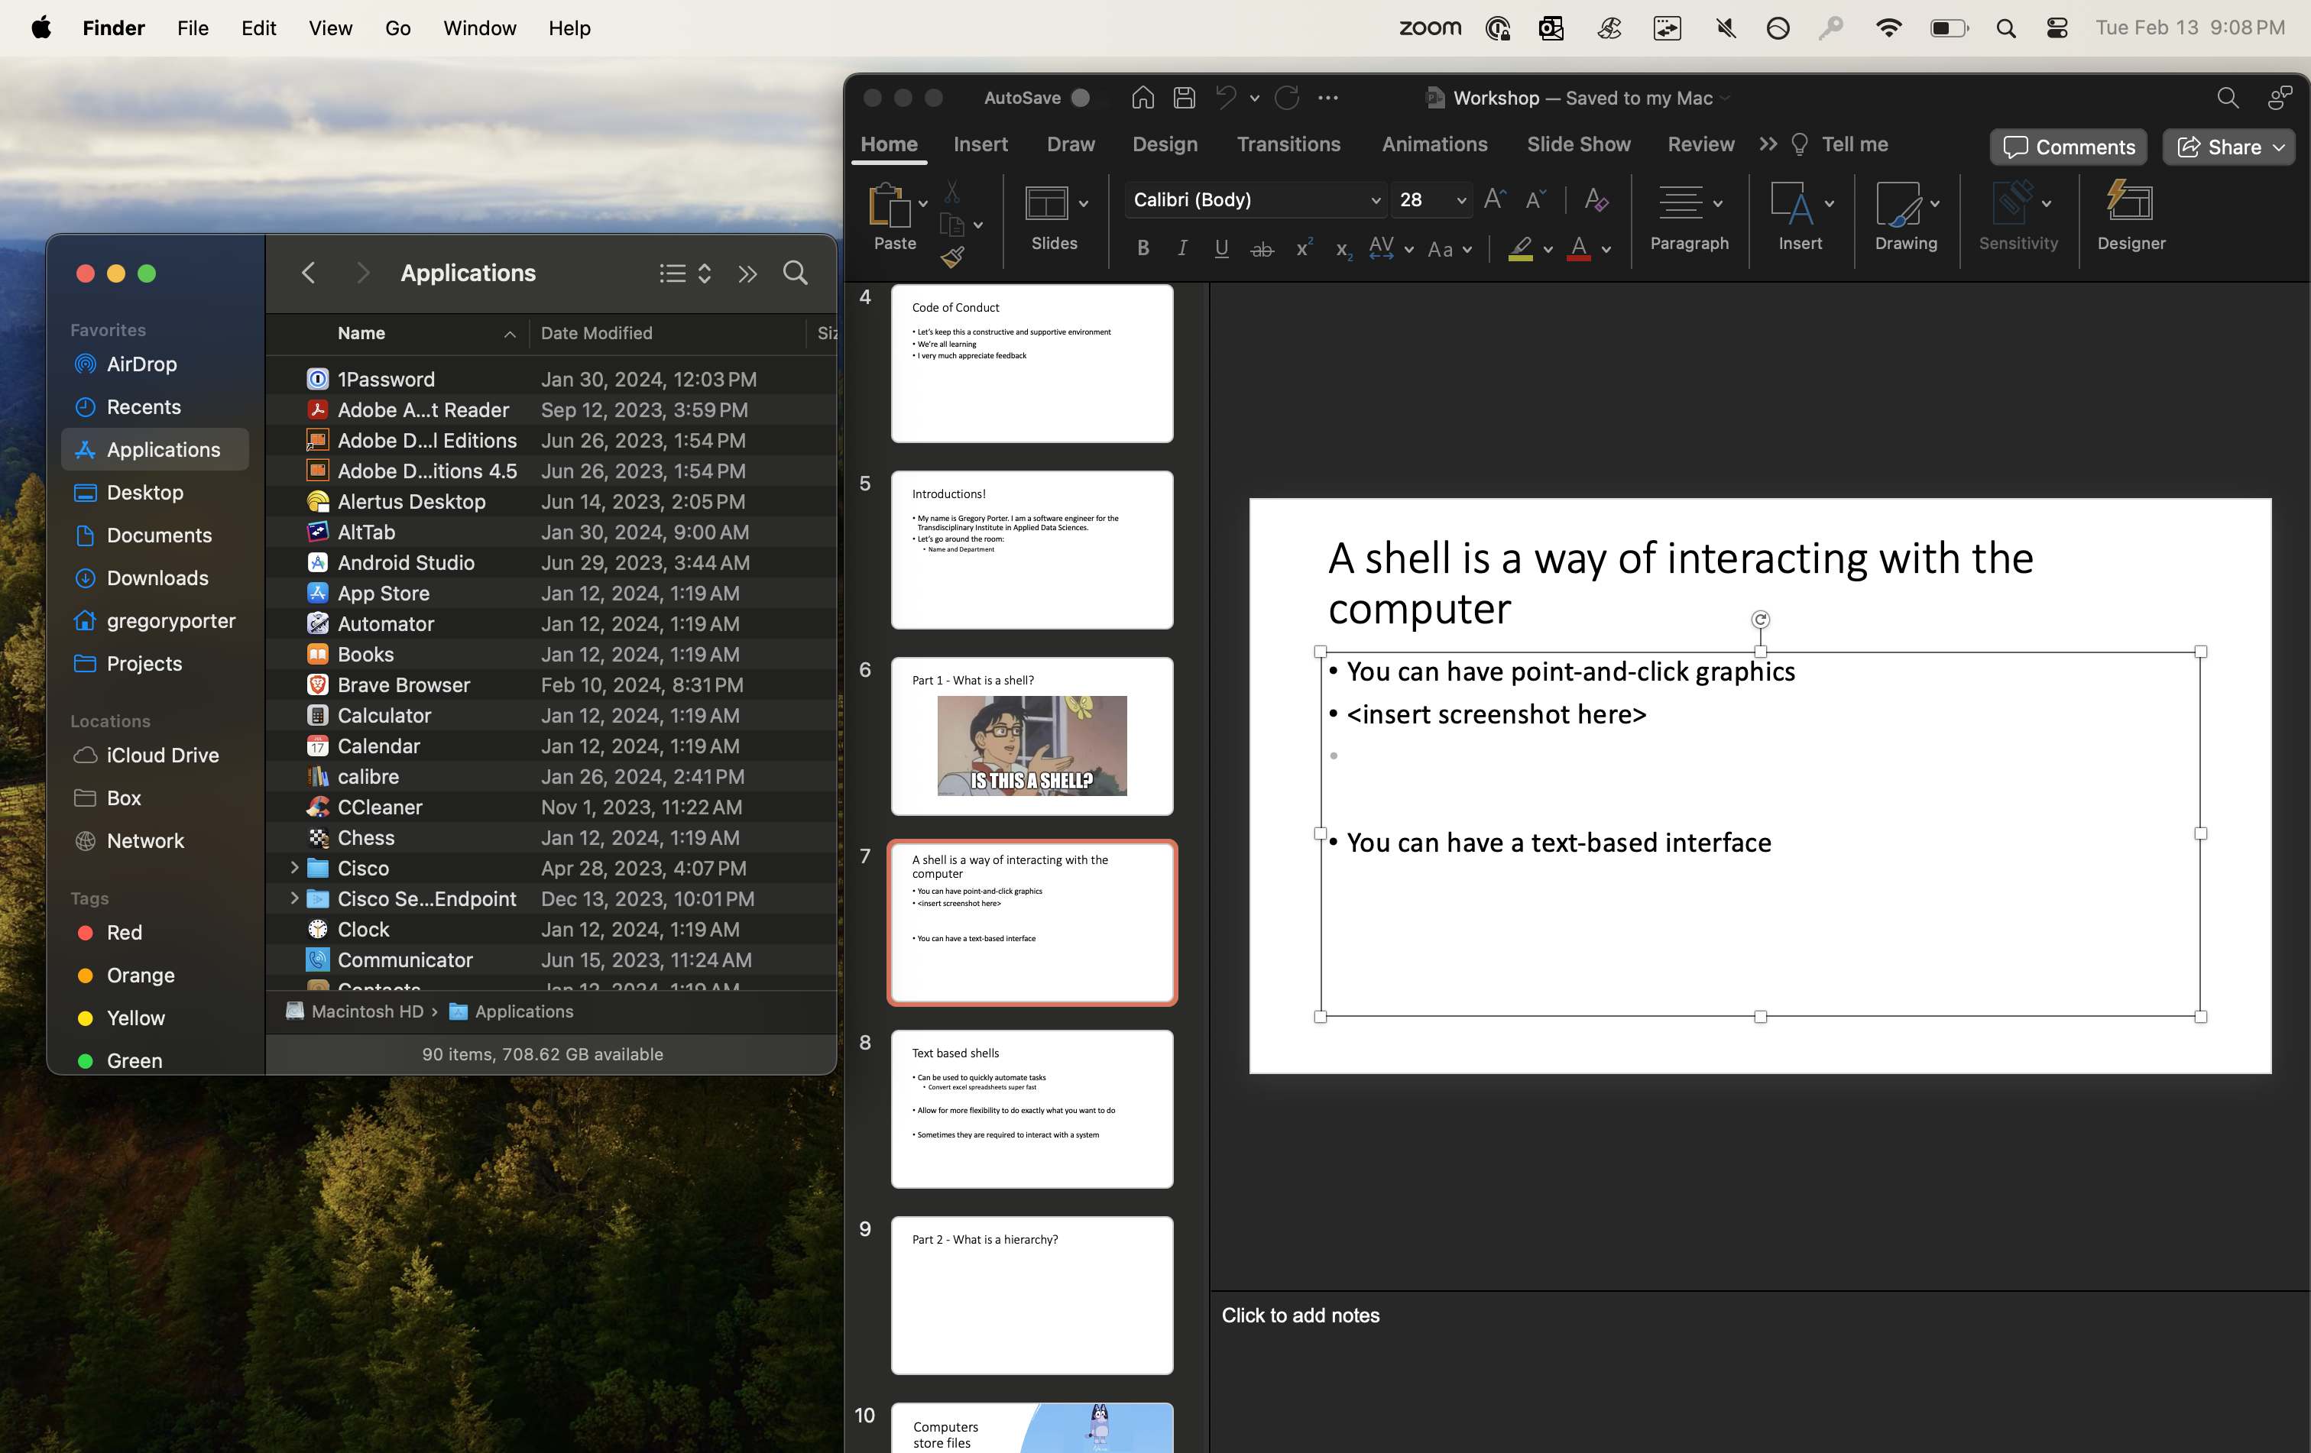
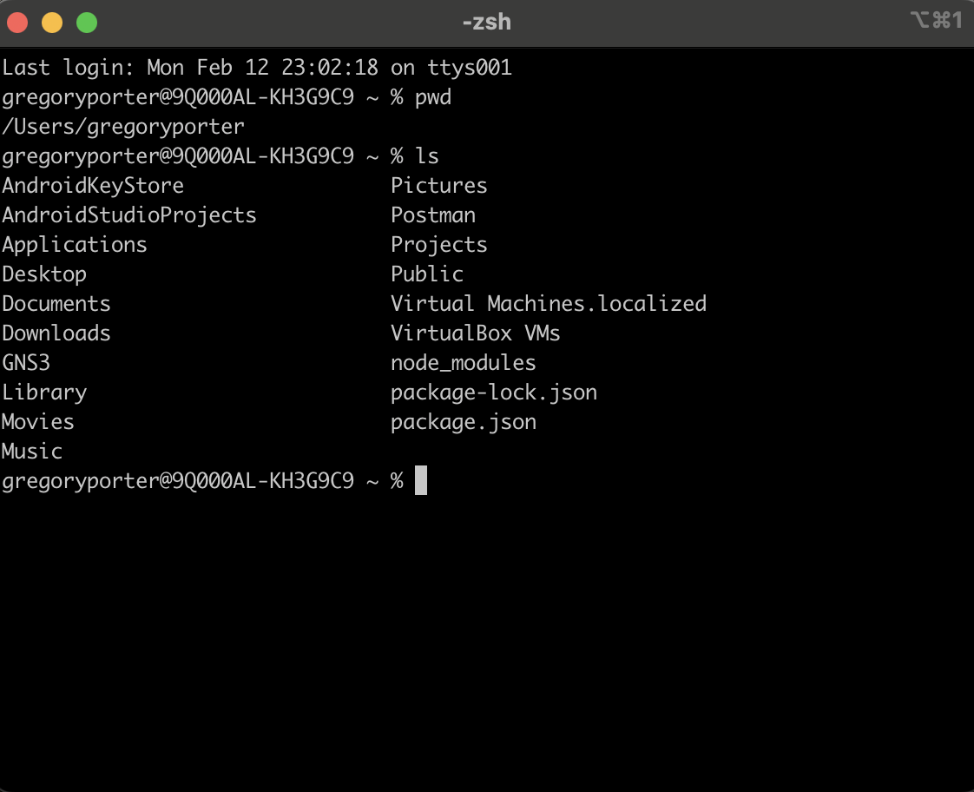
A shell is a way of interacting with the computer
You can have point-and-click graphics
You can have a text-based interface

Slide 8
Text based shells
Can be used to quickly automate tasks
Unzip all zip archives in a folder with a specific name
Allow for more flexibility to do exactly what you want to do
Sometimes they are required to interact with a system

Slide 9
Part 2 - What is a hierarchy?

Slide 10
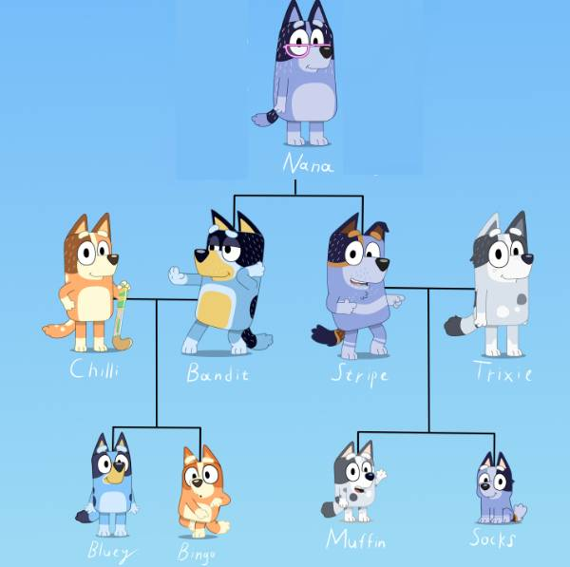
Computers store files and directories in a hierarchy

Slide 11
Imagine that each parent group is a directory: Nana Chilli-Bandit Stripe-Trixie

Slide 12
Starting with Nana, how to we get to Socks?

Slide 13
Nana, Stripe-Trixie, then Socks or turned into a path: Nana/Stripe-Trixie/Socks

Slide 14
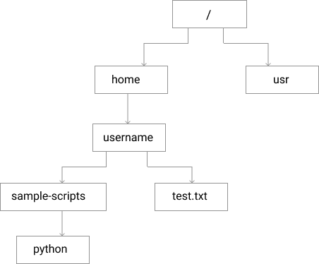
File Hierarchy

Slide 15
What is the path to test.txt?

Slide 16
What is the path to test.txt? /home/username/test.txt

Slide 17
Part 3 - What is a command?
A simple shell command consists of the command itself followed by arguments, separated by spaces.
Ex) command_name <argument1> <argument2>
Or
ls /home/username

Slide 18
Let’s jump into a couple commands
pwd – print working directory
ls – list

Slide 19
Scenario - you run ”pwd”, the terminal outputs: /home/username What do you get when you run ls?

Slide 20
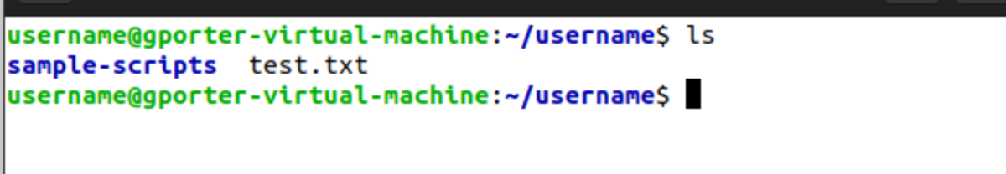

Slide 21
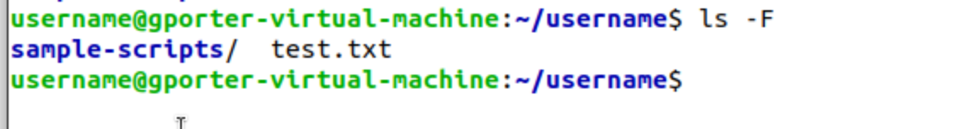

Slide 22
-F is pretty cool, what other options do we have?
Enter documentation!

Slide 23
Where to go for documentation/help
Google
Man command
tldr-pages

Slide 24
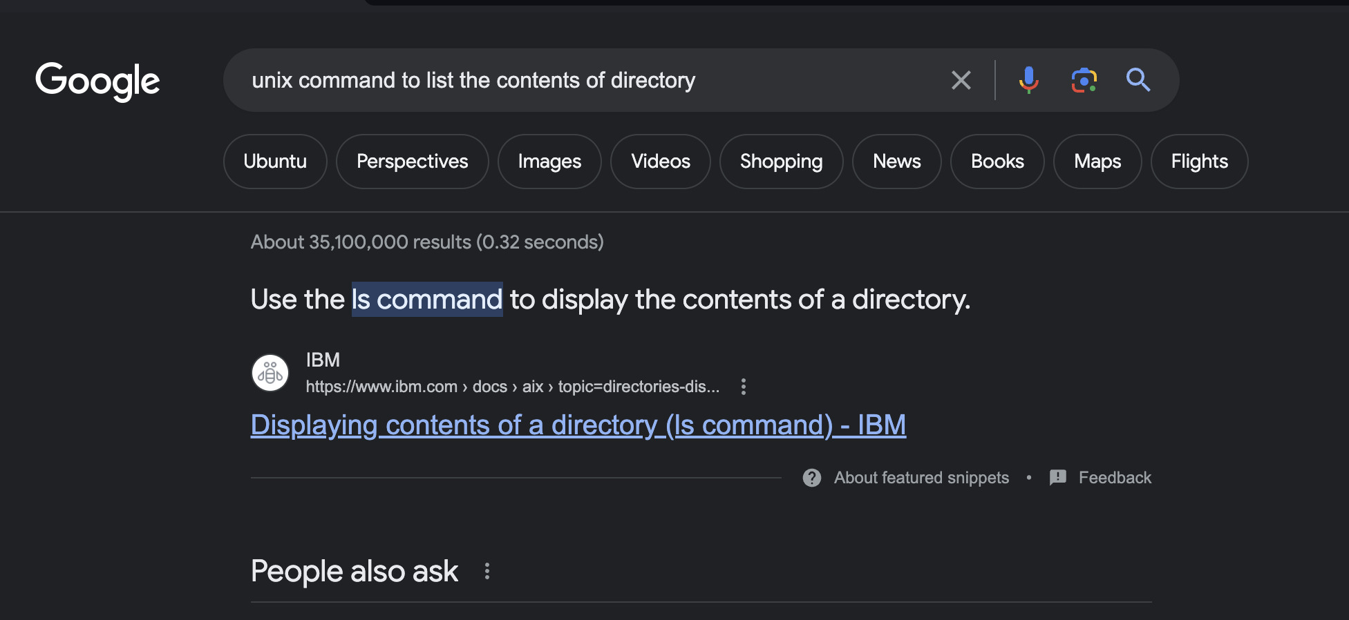
Google

Slide 25
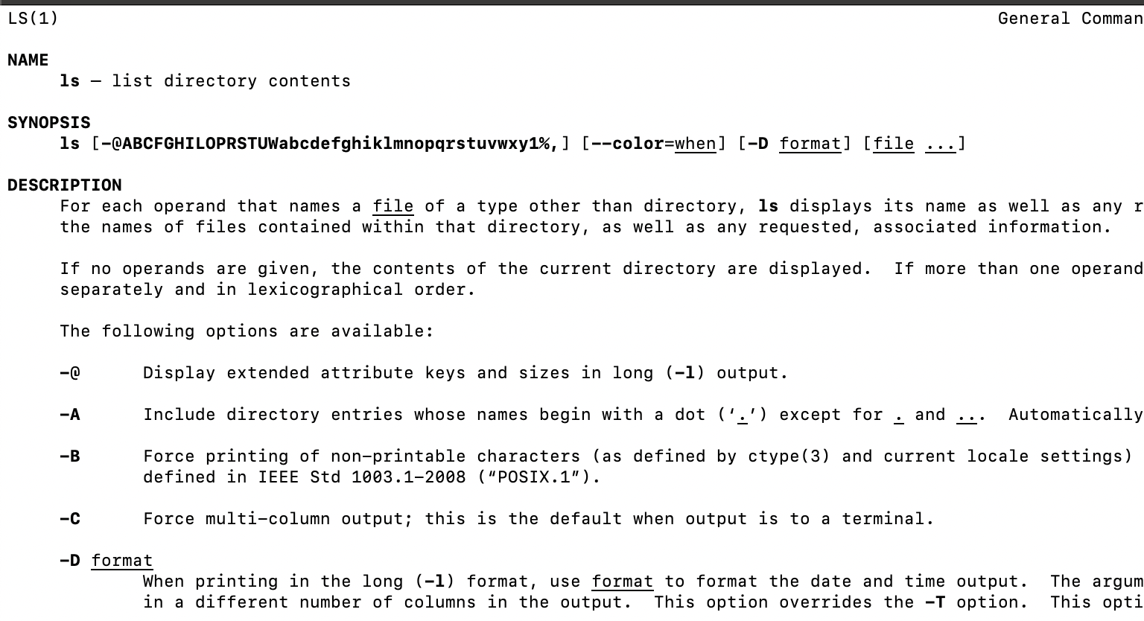
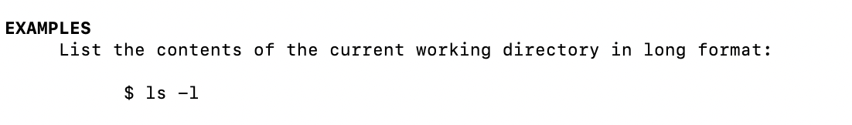
man <command> - Manual of a command
Ex) man ls

Slide 26
tldr-pages
https://tldr.inbrowser.app/
The tldr-pages project is a collection of community-maintained help pages for command-line tools, that aims to be a simpler, more approachable complement to traditional man pages.

Slide 27
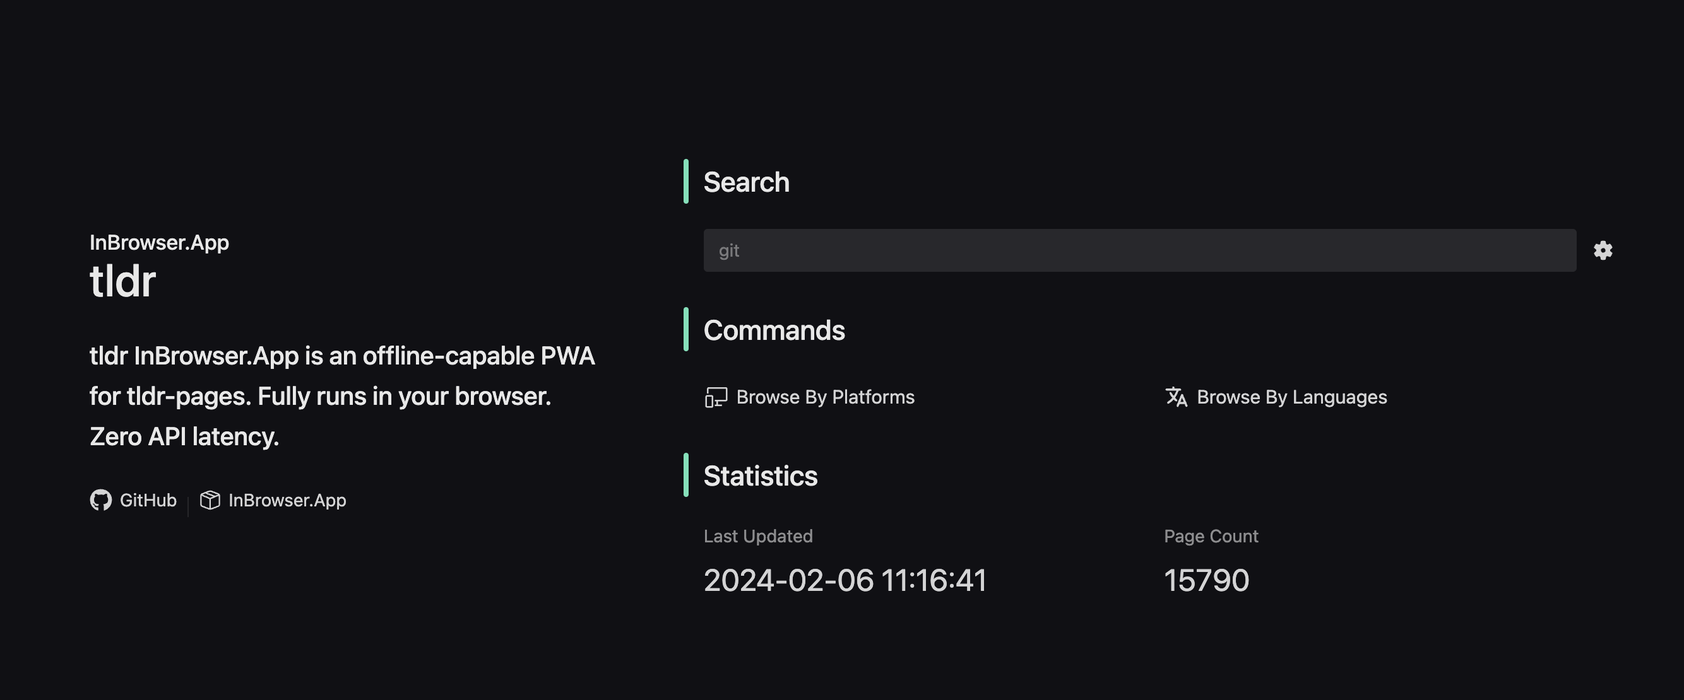
tldr-pages

Slide 28
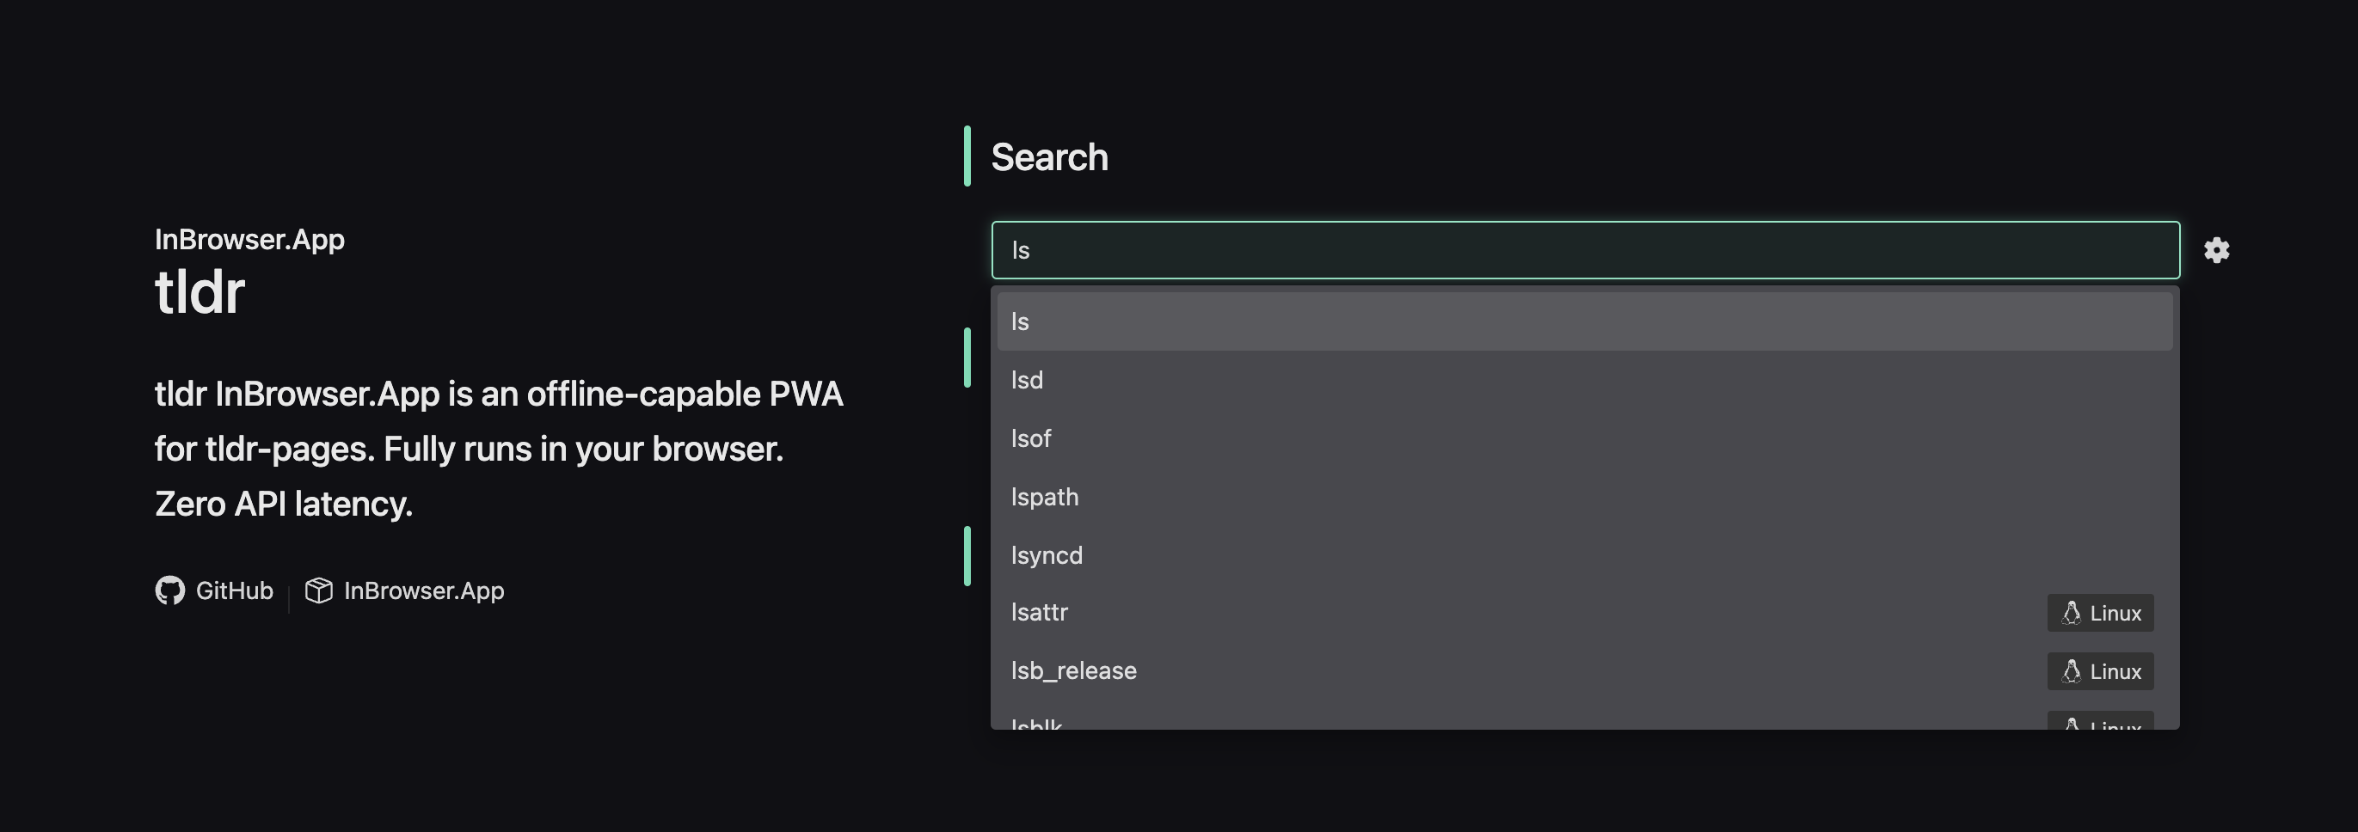
tldr-pages

Slide 29
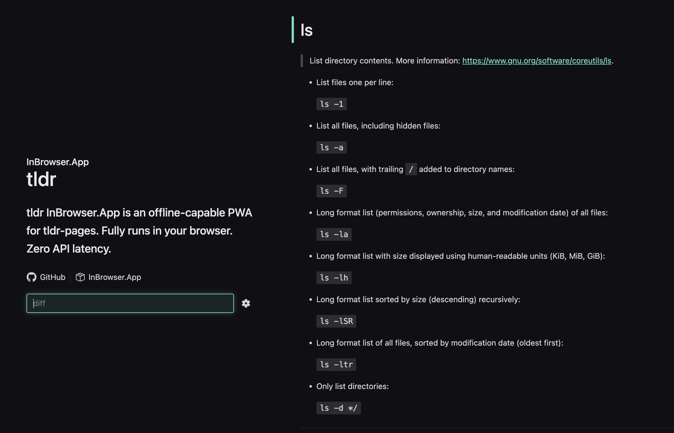
tldr-pages

Slide 30
Let’s build on our previous commands!
pwd – print working directory
ls - list
cd – change directory

Slide 31
Scenario - you run ”pwd”, the terminal outputs: /home/username How can you change directories to /usr?
Notes:
3 ways:
cd /usr
cd ../../usr
Splitting the work into multiple commands:
cd .. (this takes you to home)
cd .. (this take you to /)
cd usr
The key here is that cd (like any command) will consider the current working directory as it’s scope. The command itself is aware of the directories in the current working directory (which includes a link to its parent). With that in mind, you can’t just run “cd usr” because the directory “usr” doesn’t exist in the directory “username”.
A full path works (in the case of cd /usr) because by beginning with the slash, you are telling the cd command to travel all the way back up the hierarchy to Root and then travel downwards.

Slide 32
Common commands
cd – change directory
ls – list
pwd – print working directory
mkdir – make directory
rmdir – remove directory
rm – remove (file)
mv - move
cp - copy
cat – concatenate and output
less – opens it for reading
find – find files
Notes:
We discussed how “cat” was interesting. The use of it is to concatenate files together and then output the resultant file to the terminal. A side effect of this (and a more common use of it) is to run cat <single_file>
This will concatenate the file with nothing and then just output it to the terminal. That is, it allows you to read the contents of a file.
Less – a way to read the contents of a file in the same way you read a Man page.
rmdir - removes EMPTY directories. It’ll give you an error if you try to remove a directory that isn’t empty. Given this, it’s considered a best practice to individually remove files using rm or move them and then run rmdir.

Slide 33
Let’s combine it into a more complex example
http://tinyurl.com/triads-bash-zip

Slide 34
Piping practice! What does this do?
ls | grep 'file’ > people.txt
Notes:
ls will output a list of the contents in the current directory
| will pipe that list into grep
grep will look for items (files and directories) in the provided list that contain “file”
> Means to take output of the previous command (grep) and save it to a file
people.txt is the name of the new file

Slide 35
In sum
What is a shell?
What is a hierarchy?
What is a command?
Where can I go for help?
Built confidence in how to interact with the command line.

Slide 36
Thank you very much!
Contact info:
Gregory Porter
G.porter@wustl.edu

